Slide 1
A First Book of ANSI C Fourth Edition
Chapter 8
Arrays

Slide 2
Objectives
One-Dimensional Arrays
Array Initialization
Arrays as Function Arguments
Case Study: Computing Averages and Standard Deviations
Two-Dimensional Arrays
Common Programming and Compiler Errors

Slide 3
Introduction
Atomic variable: variable whose value cannot be further subdivided into a built-in data type
Also called a scalar variable
Data structure (aggregate data type): data type with two main characteristics
Its values can be decomposed into individual data elements, each of which is either atomic or another data structure
It provides an access scheme for locating individual data elements within the data structure

Slide 4
Introduction (continued)
One of the simplest data structures, called an array, is used to store and process a set of values, all of the same data type, that forms a logical group

Slide 5
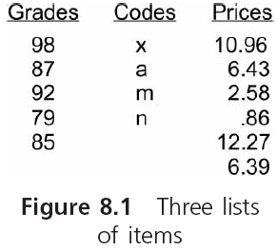
Introduction (continued)

Slide 6
One-Dimensional Arrays
A one-dimensional array, also called a single-dimensional array and a single-subscript array, is a list of values of the same data type that is stored using a single group name

Slide 7
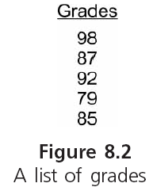
One-Dimensional Arrays (continued)

Slide 8
One-Dimensional Arrays (continued)
To create a one-dimensional array:
#define NUMELS 5
int grades[NUMELS];
In C, the starting index value for all arrays is 0
Each item in an array is called an element or component of the array

Slide 9
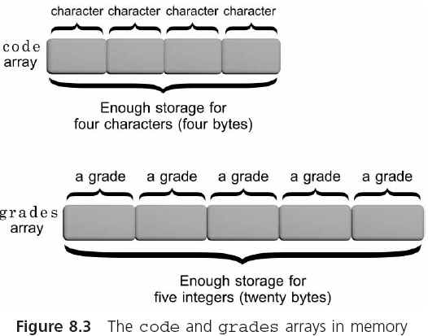
One-Dimensional Arrays (continued)

Slide 10
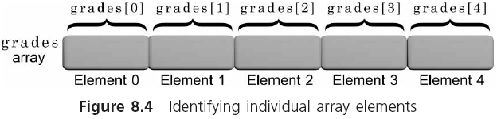
One-Dimensional Arrays (continued)
Any element can be accessed by giving the name of the array and the element’s position
The position is the element’s index or subscript
Each element is called an indexed variable or a subscripted variable

Slide 11
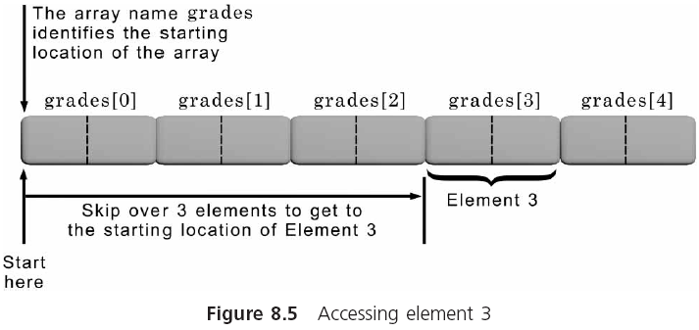
One-Dimensional Arrays (continued)

Slide 12
One-Dimensional Arrays (continued)
Subscripted variables can be used anywhere scalar variables are valid
grades[0] = 98;
grades[1] = grades[0] - 11;
Any expression that evaluates an integer may be used as a subscript
grades[i]
grades[2*i]
grades[j-i]

Slide 13
One-Dimensional Arrays (continued)
sequence easily through an array, element by element with a for loop
#define NUMELS 5
total = 0; /* initialize total to zero */
for (i = 0; i < NUMELS; i++)
total = total + grades[i]; /* add a grade */

Slide 14
Input and Output of Array Values
Individual array elements can be assigned values using individual assignment statements or, interactively, using the scanf() function
#define NUMELS 5
for(i = 0; i < NUMELS; i++)
{
printf("Enter a grade: ");
scanf("%d", &grades[i]);
}
Be careful: C does not check the value of the index being used (called a bounds check)

Slide 15
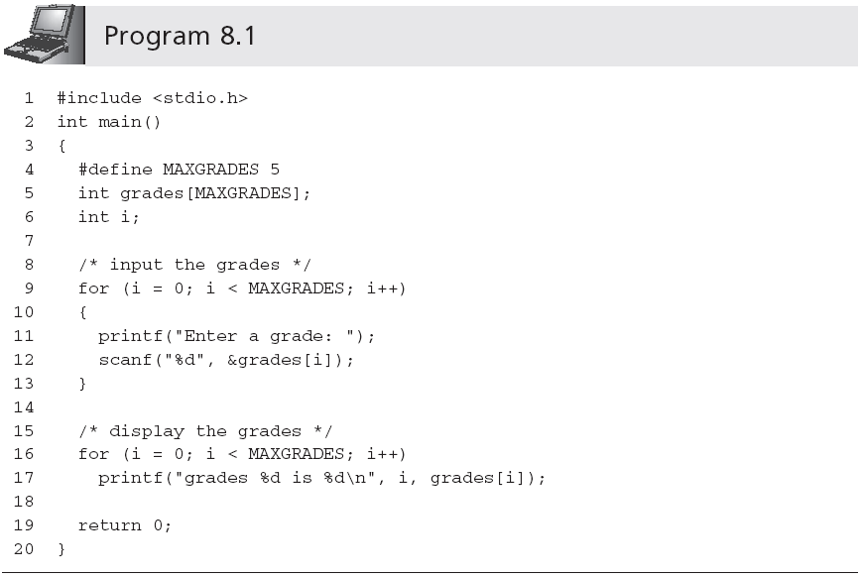
Sample output:
Enter a grade: 85
Enter a grade: 90
Enter a grade: 78
Enter a grade: 75
Enter a grade: 92
grades 0 is 85
grades 1 is 90
grades 2 is 78
grades 3 is 75
grades 4 is 92

Slide 16
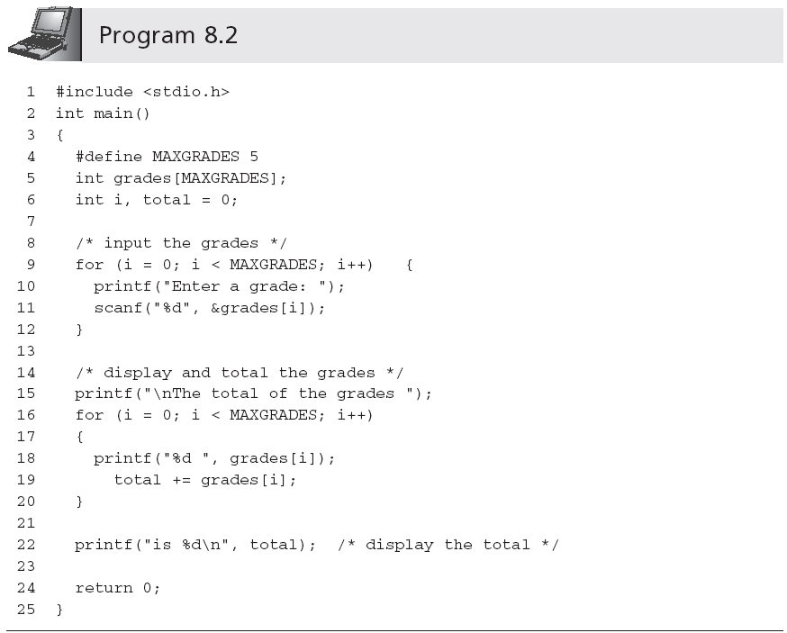
Statement is outside of the second for loop; total is displayed only once, after all values have been added

Slide 17

一维数组程序举例
用数组处理求Fibonacci数列问题
解题思路：
用简单变量易处理，缺点不能在内存中保存这些数。假如想直接输出数列中第25个数，是很困难的。
如果用数组处理，每一个数组元素代表数列中的一个数，依次求出各数并存放在相应的数组元素中

Slide 18
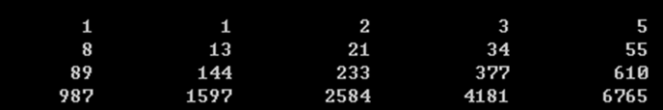
#include <stdio.h>
int main()
{ int i; int f[20]={1,1};
for(i=2;i<20;i++)
f[i]=f[i-2]+f[i-1];
for(i=0;i<20;i++)
{ if(i%5==0) printf(“\n”);
printf(“%12d”,f[i]);
}
printf("\n");
return 0;
}

Slide 19
Array Initialization
The individual elements of all global and static arrays (local or global) are, by default, set to 0 at compilation time
The values within auto local arrays are undefined

Slide 20
1 #define SIZE1 20
2 #define SIZE2 25
3 #define SIZE3 15
4
5 int gallons[SIZE1]; /* a global array */
6 static int dist[SIZE2]; /* a static global array */
7
8 int main()
9 {
10 int miles[SIZE3]; /* an auto local array */
11 static int course[SIZE3]; /* static local array */
12 .
13 .
14 return 0;
15 }

Slide 21
Array Initialization (continued)
Examples of initializations:
int grades[5] = {98, 87, 92, 79, 85};
double length[7] = {8.8, 6.4, 4.9, 11.2};
char codes[6] = {'s', 'a', 'm', 'p', 'l', e'};
char codes[] = {'s', 'a', 'm', 'p', 'l', 'e'};

Slide 22
一维数组的初始化
在定义数组的同时，给各数组元素赋值
int a[10]={0,1,2,3,4,5,6,7,8,9};
int a[10]={0,1,2,3,4};相当于
int a[10]={0,1,2,3,4,0,0,0,0,0};
int a[10]={0,0,0,0,0,0,0,0,0,0};相当于
int a[10]={0};
int a[5]={1,2,3,4,5};可写为
int a[ ]={1,2,3,4,5};

Slide 23
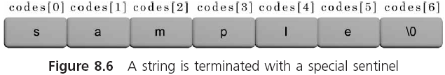
Array Initialization (continued)
char codes[] = “sample”; /* no brace and comma，
size is 7 */
The NULL character, which is the escape sequence \0, is automatically appended to all strings by the C compiler

Slide 24
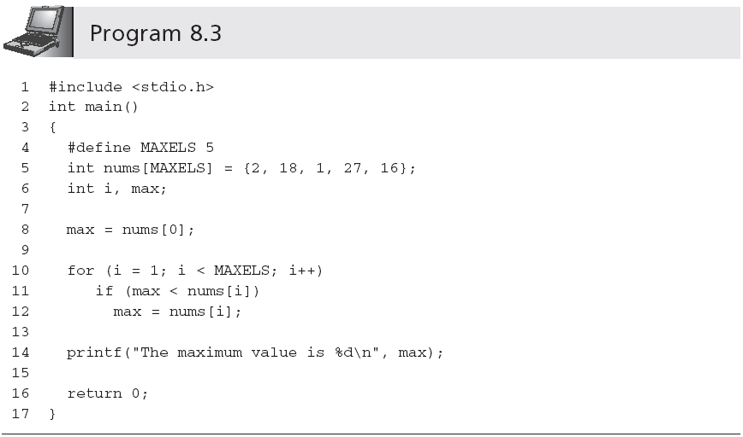
Array Initialization (continued)

Slide 25
Arrays as Function Arguments
Individual array elements are passed to a function by including them as subscripted variables in the function call argument list
findMin(grades[2], grades[6]);
Pass by value

Slide 26
When passing a complete array to a function, the called function receives access to the actual array, rather than a copy of the values in the array
findMax(grades);
Pass by reference

Slide 27
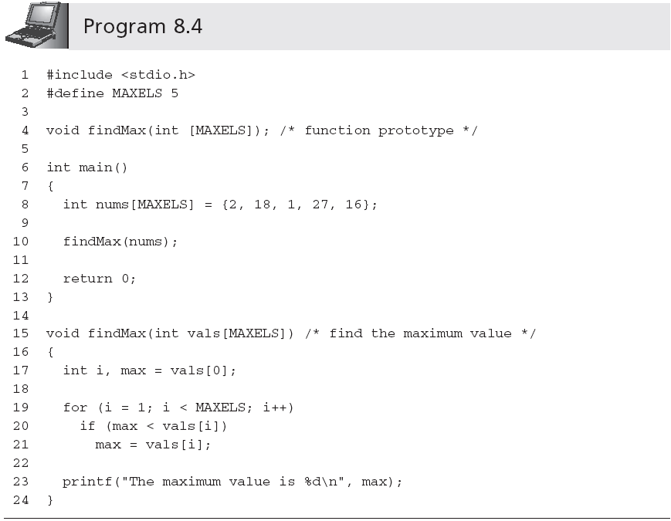
Size can be omitted

Slide 28
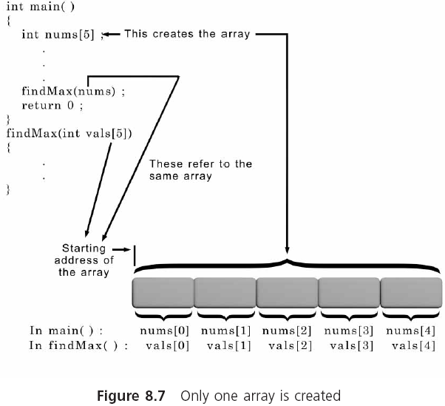

Slide 29
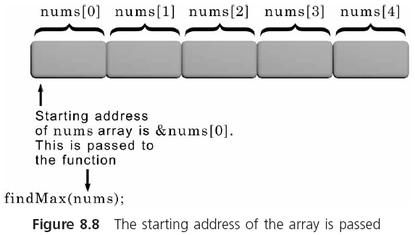
Arrays as Function Arguments (continued)

Slide 30
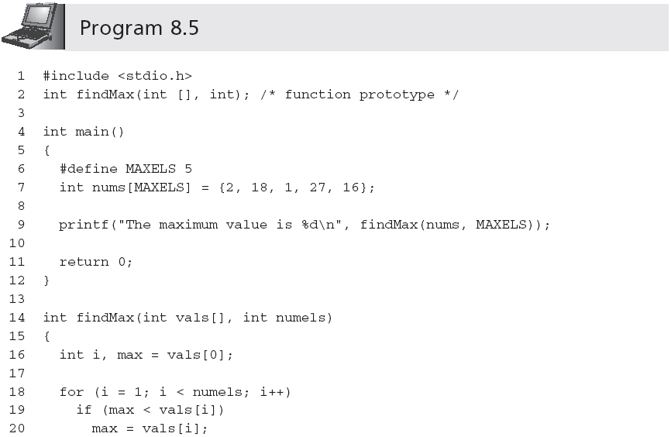

Slide 31
Case Study: Computing Averages and Standard Deviations
Two statistical functions are created to determine the average and standard deviation, respectively, of an array of numbers

Slide 32
Requirements Specification
Need two functions
Determine the average…
Determine the standard deviation…
…of a list of integer numbers
Each function must accept the numbers as an array and return the calculated values to the calling function
We now apply the top-down development procedure to developing the required functions

Slide 33
Analyze the Problem
Determine the input items: list of integer numbers
Determine the desired outputs:
(1) average,
(2) standard deviation
List the algorithms relating the inputs and outputs:
Average Function: Calculate the average by adding the grades and dividing by the # of added grades

Slide 34
Standard Deviation Function:
Subtract the average from each individual grade. Each number in the new set is called a deviation.
Square each deviation found in Step 1.
Add the squared deviations and divide the sum by the number of deviations.
The square root of the number found in Step 3 is the standard deviation.

Slide 35
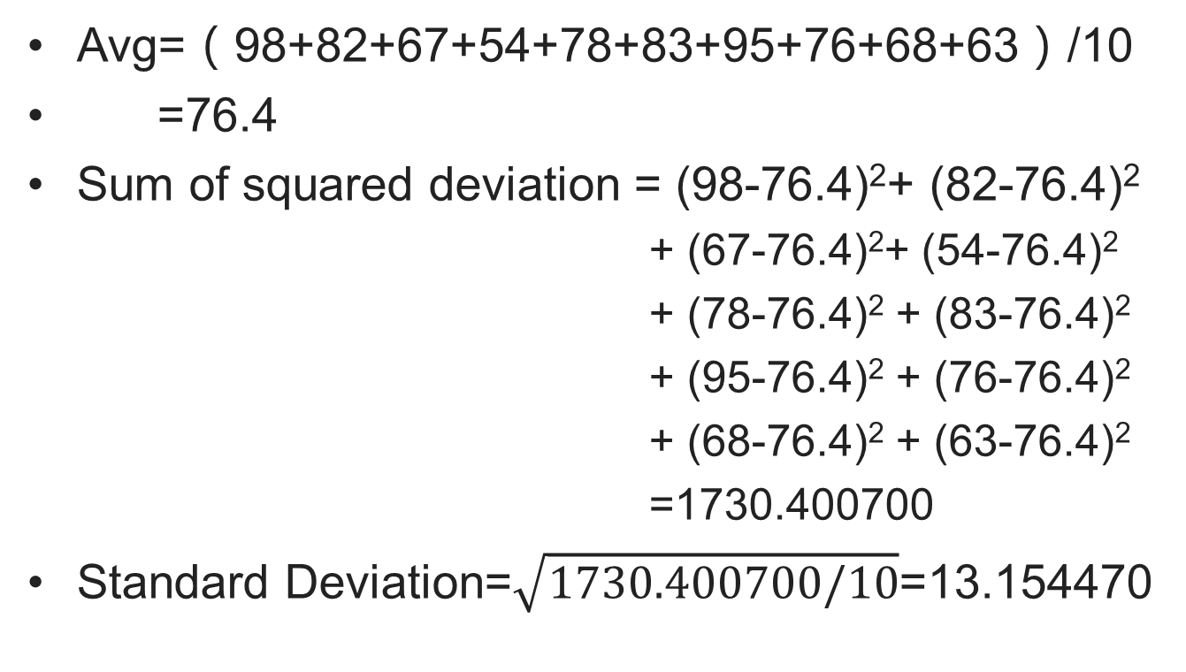
Hand Calculation

Slide 36
Select an Overall Solution
Problem-Solver Algorithm is adapted:
Initialize an array of integers
Call the average function
Call the standard deviation function
Display the returned value of the average function
Display the returned value of the standard deviation function

Slide 37
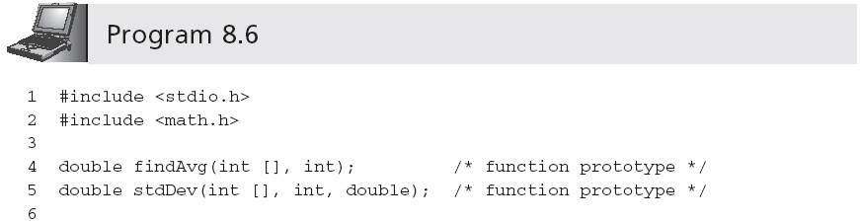
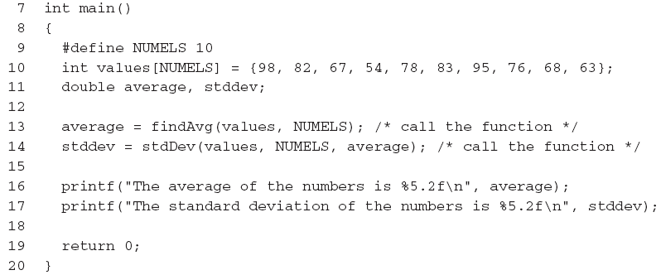
Write the Functions

Slide 38
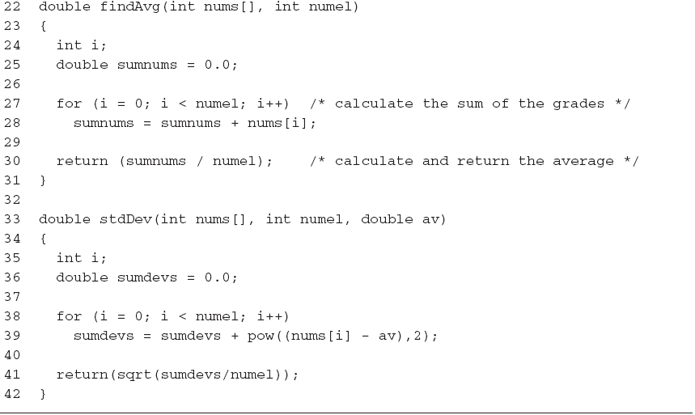

Slide 39
Test and Debug the Functions
Write a main() program unit to call the function and display the returned results (see Program 8.6)
A test run using Program 8.6 produced the following display:
The average of the numbers is 76.40
The standard deviation of the numbers is 13.15

Slide 40
Two-Dimensional Arrays
A two-dimensional array, or table, consists of both rows and columns of elements
int val[3][4];

Slide 41
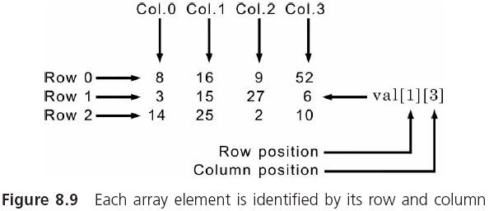
Two-Dimensional Arrays (continued)

Slide 42
Two-Dimensional Arrays (continued)
Initialization:
#define NUMROWS 3
#define NUMCOLS 4
int val[NUMROWS][NUMCOLS] = { {8,16,9,52},
{3,15,27,6},
{14,25,2,10} };
The inner braces can be omitted:
int val[NUMROWS][NUMCOLS] = {8,16,9,52,3,15,27, 6,14,25,2,10};
Initialization is done in row order

Slide 43
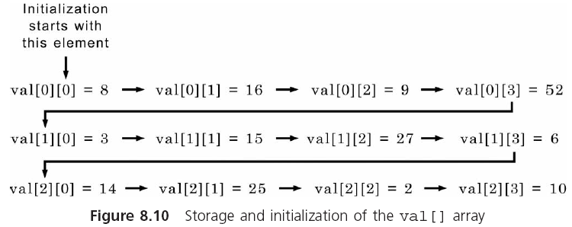
Two-Dimensional Arrays (continued)

Slide 44
二维数组的初始化
int a[3][4]={{1,2,3,4},{5,6,7,8},
{9,10,11,12}};
int a[3][4]={1,2,3,4,5,6,7,8,9,10,11,12};
int a[3][4]={{1},{5},{9}};等价于
int a[3][4]={{1,0,0,0},{5,0,0,0},
{9,0,0,0}};
int a[3][4]={{1},{5,6}};相当于
int a[3][4]={{1},{5,6},{0}};

Slide 45
二维数组的初始化
int a[3][4]={1,2,3,4,5,6,7,8,9,10,11,12};
等价于：
int a[ ][4]={1,2,3,4,5,6,7,8,9,10,11,12};
int a[][4]={{0,0,3},{ },{0,10}};合法

Slide 46
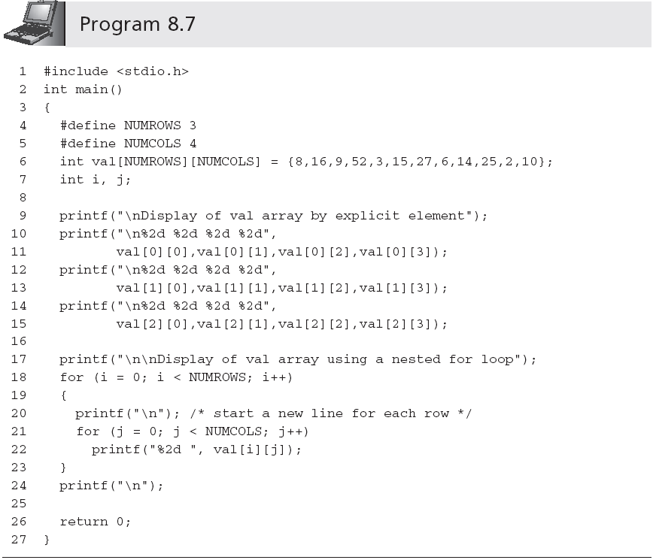

Slide 47
Two-Dimensional Arrays (continued)
The display produced by Program 8.7 is
Display of val array by explicit element
8 16 9 52
3 15 27 6
14 25 2 10
Display of val array using a nested for loop
8 16 9 52
3 15 27 6
14 25 2 10

Slide 48
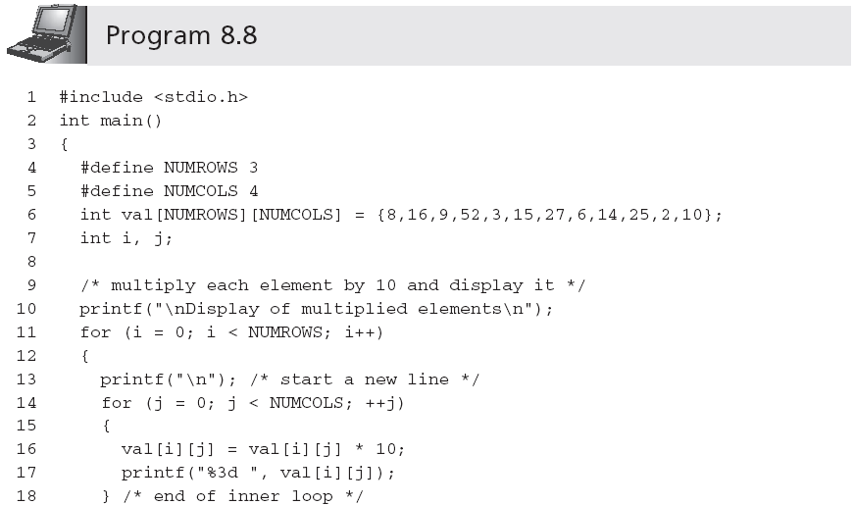
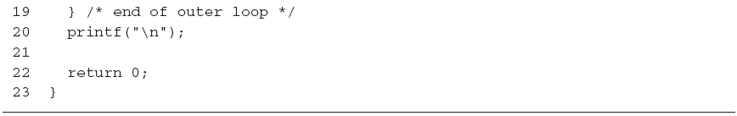

Slide 49
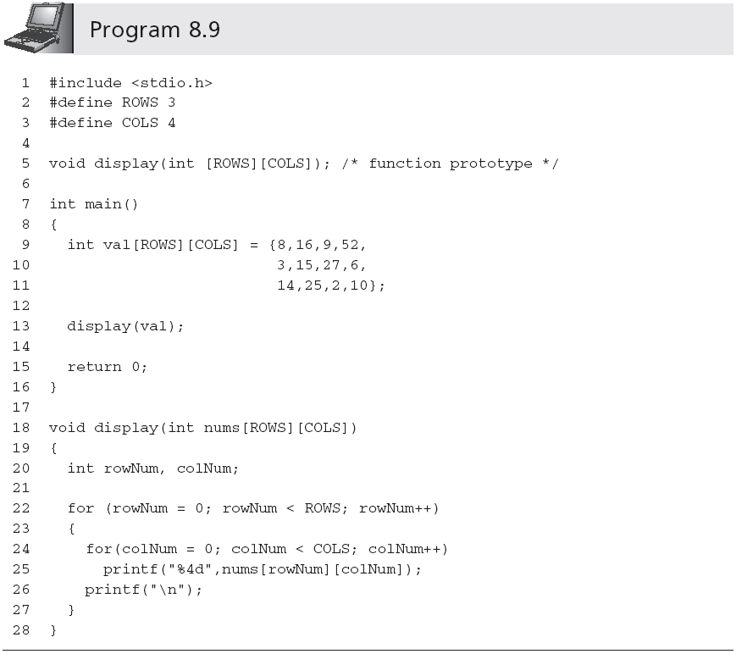
Two-Dimensional Arrays (continued)
Row size can be omitted

Slide 50
Internal Array Element Location Algorithm
Each element in an array is reached by adding an offset to the starting address of the array
Address element i = starting array address + offset

Slide 51
For single-dimensional arrays: Offset = i  the size of an individual element

Slide 52
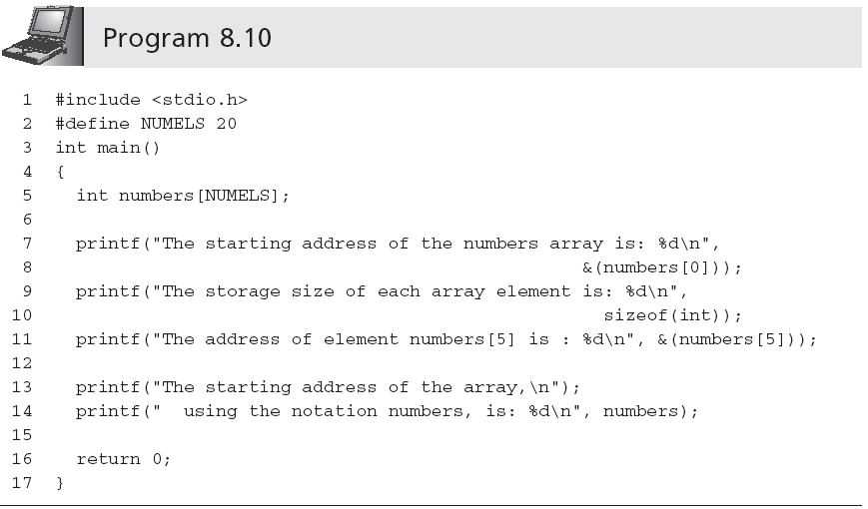
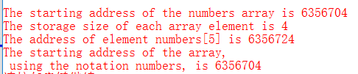
Internal Array Element Location Algorithm

Slide 53
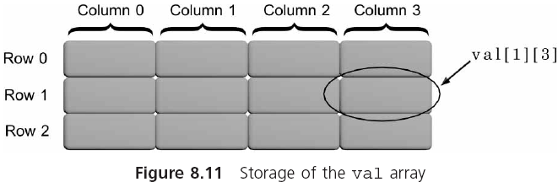
Two-Dimensional Arrays (continued)

Slide 54
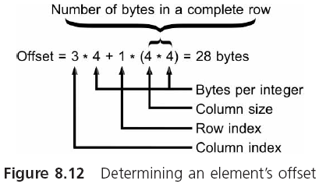
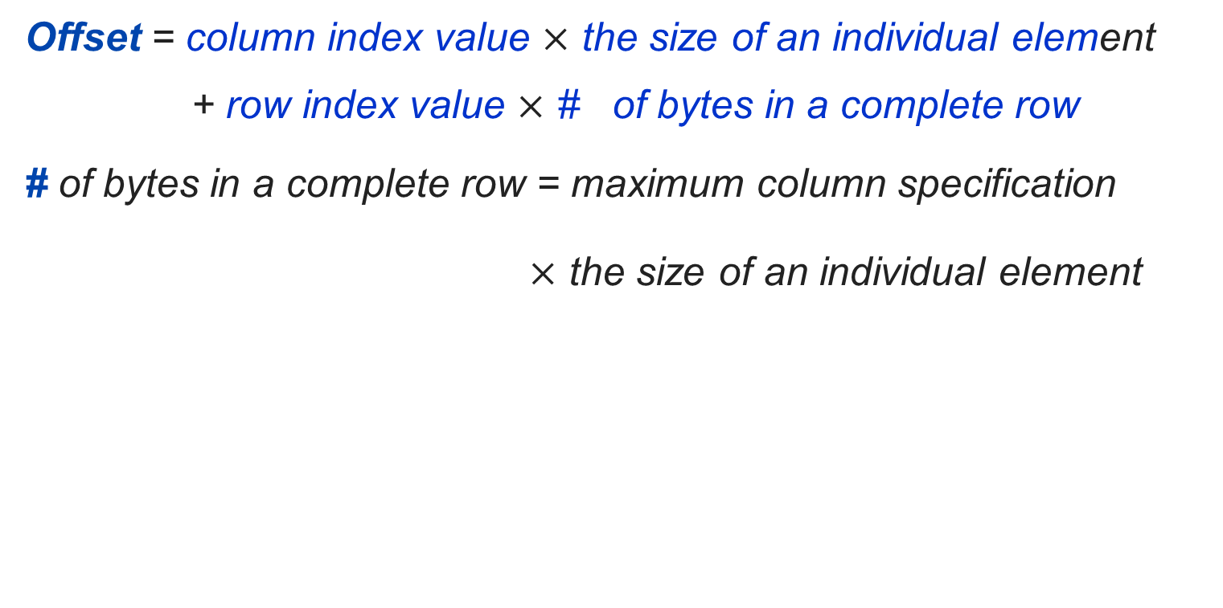

Slide 55
int ab[3][4]; ab地址为10020, int 四个字节大小
&ab[1][3]是多少？

Slide 56
int ab[3][4];
char *ptr = (char*)ab;
ptr += 20;
ptr对应哪个元素？

Slide 57
int ab[3][4]; int 四个字节大小
int *ptr = ab;
ptr += 20;
ptr是多少？

Slide 58
Larger Dimensional Arrays
A three-dimensional array can be viewed as a book of data tables (the third subscript is called the rank)
int response[4][10][6];
A four-dimensional array can be represented as a shelf of books where the fourth dimension is used to declare a desired book on the shelf

Slide 59
A five-dimensional array can be viewed as a bookcase filled with books where the fifth dimension refers to a selected shelf in the bookcase
Arrays of three, four, five, six, or more dimensions can be viewed as mathematical n-tuples

Slide 60
for(i=0;i<5;i++)
if (a[i]>a[i+1])
{ t=a[i];a[i]=a[i+1];a[i+1]=t; }
a[0]
a[1]
a[2]
a[3]
a[4]
a[5]
9
8
5
4
2
0
8
9
5
4
2
0
8
5
9
4
2
0
8
5
4
9
2
0
8
5
4
2
9
0
8
5
4
2
0
9
大数沉淀，小数起泡

Slide 61
for(i=0;i<4;i++)
if (a[i]>a[i+1])
{ t=a[i];a[i]=a[i+1];a[i+1]=t; }
a[0]
a[1]
a[2]
a[3]
a[4]
a[5]
8
5
4
2
0
9
5
8
4
2
0
9
5
4
8
2
0
9
5
4
2
8
0
9
5
4
2
0
8
9

Slide 62
for(i=0;i<3;i++)
if (a[i]>a[i+1])
{ t=a[i];a[i]=a[i+1];a[i+1]=t; }
a[0]
a[1]
a[2]
a[3]
a[4]
a[5]
5
4
2
0
8
9
4
5
2
0
8
9
4
2
5
0
8
9
4
2
0
5
8
9

Slide 63
for(i=0;i<2;i++)
if (a[i]>a[i+1])
{ t=a[i];a[i]=a[i+1];a[i+1]=t; }
a[0]
a[1]
a[2]
a[3]
a[4]
a[5]
4
2
0
5
8
9
2
4
0
5
8
9
2
0
4
5
8
9

Slide 64
for(i=0;i<1;i++)
if (a[i]>a[i+1])
{ t=a[i];a[i]=a[i+1];a[i+1]=t; }
a[0]
a[1]
a[2]
a[3]
a[4]
a[5]
2
0
4
5
8
9
0
2
4
5
8
9

Slide 65
有一个3×4的矩阵，要求编程序求出其中值最大的那个元素的值，以及其所在的行号和列号。
解题思路：采用“打擂台算法”
先找出任一人站在台上，第2人上去与之比武，胜者留在台上
第3人与台上的人比武，胜者留台上，败者下台
以后每一个人都是与当时留在台上的人比武，直到所有人都上台比为止，最后留在台上的是冠军

Slide 66
有一个3×4的矩阵，要求编程序求出其中值最大的那个元素的值，以及其所在的行号和列号。
解题思路：采用“打擂台算法”
先把a[0][0]的值赋给变量max
max用来存放当前已知的最大值
a[0][1]与max比较，如果a[0][1]>max，则表示a[0][1]是已经比过的数据中值最大的，把它的值赋给max，取代了max的原值
以后依此处理，最后max就是最大的值

Slide 67
max=a[0][0]
for i=0 to 2
for j=0 to 3
a[i][j]>max
max=a[i][j]
row=I
colum=j
真
假
输出：max,row,colum

Slide 68

……
int i,j,row=0,colum=0,max;
int a[3][4]={{1,2,3,4},{9,8,7,6},
{-10,10,-5,2}};
max=a[0][0];
for (i=0;i<=2;i++)
for (j=0;j<=3;j++)
if (a[i][j]>max)
{ max=a[i][j]; row=i; colum=j; }
printf("max=%d\nrow=%d\n
colum=%d\n",max,row,colum);
……
记列号
记最大值
记行号

Slide 69
Common Programming Errors
Forgetting to declare the array
Using a subscript that references a nonexistent array element
Not using a large enough conditional value in a for loop counter to cycle through all the array elements
Forgetting to initialize the array

Slide 70
Summary
A single-dimensional array is a data structure that can store a list of values of the same data type
Elements are stored in contiguous locations
Referenced using the array name and a subscript
Single-dimensional arrays may be initialized when they are declared
Single-dimensional arrays are passed to a function by passing the name of the array as an argument

Slide 71
Summary (continued)
A two-dimensional array is declared by listing both a row and a column size with the data type and name of the array
Two-dimensional arrays may be initialized when they are declared
Two-dimensional arrays are passed to a function by passing the name of the array as an argument

Slide 72
练习
（1）作业：用户输入一组的乱序正整数，求最大、最小，以及排序（有小到大或由大到小）。
扩展：（a）数组中相邻元素两两比较，根据比较结果交换顺序（按大数在前小数在后，或小数在前大数在后的规则交换相邻数据），重复此过程直到没有数据可以交换；
（b）与直接暴力排序相对照，看（a）中使用相邻交换排序算法计算次数有无优化（可以通过打印各自的计算次数来评估结果），每次比较、赋值等都是一次计算。
（2）输入一个矩阵，将其行与列互换（转置），然后打印输出
扩展：(a) 矩阵相加；
(b) 矩阵相乘。
课后练习：（a）多维数组的使用；
（b）字符大小写转换、实数的上下取整；
（c）字符串与数值间的转换等等。

Slide 73
void BubbleSort(int arr[], int number)
{
number--;
for (int i = 0; i < number; i++)
{
for (int j = 0; j < number - i; j++)
{
if (arr[j] > arr[j + 1])
{
int tmp = arr[j + 1];
arr[j + 1] = arr[j];
arr[j] = tmp;
}
}
}
}

Slide 74
char codes[] = “sample”;
char codes[] = {'s', 'a', 'm', 'p', 'l', 'e'};

Slide 75
int aray[10];
int *p1 = NULL,*p2 = NULL;
p1 = &aray[0];
p2 = aray;
问：p1?=p2

